Slide 1

ALY 6110 Data Management and Big Data Final Project Instructor: Mako Jonas
Dhanashree Chavan
Karishma Dinesh Vadher
Venkata Ramya Poondla

Slide 2

Introduction
Topic Introduction
Corona Virus origin
Spread
Effects
Data Set Introduction
Case data
Patient data
Time series data
Methodolgy
Python
Tableau

Slide 3
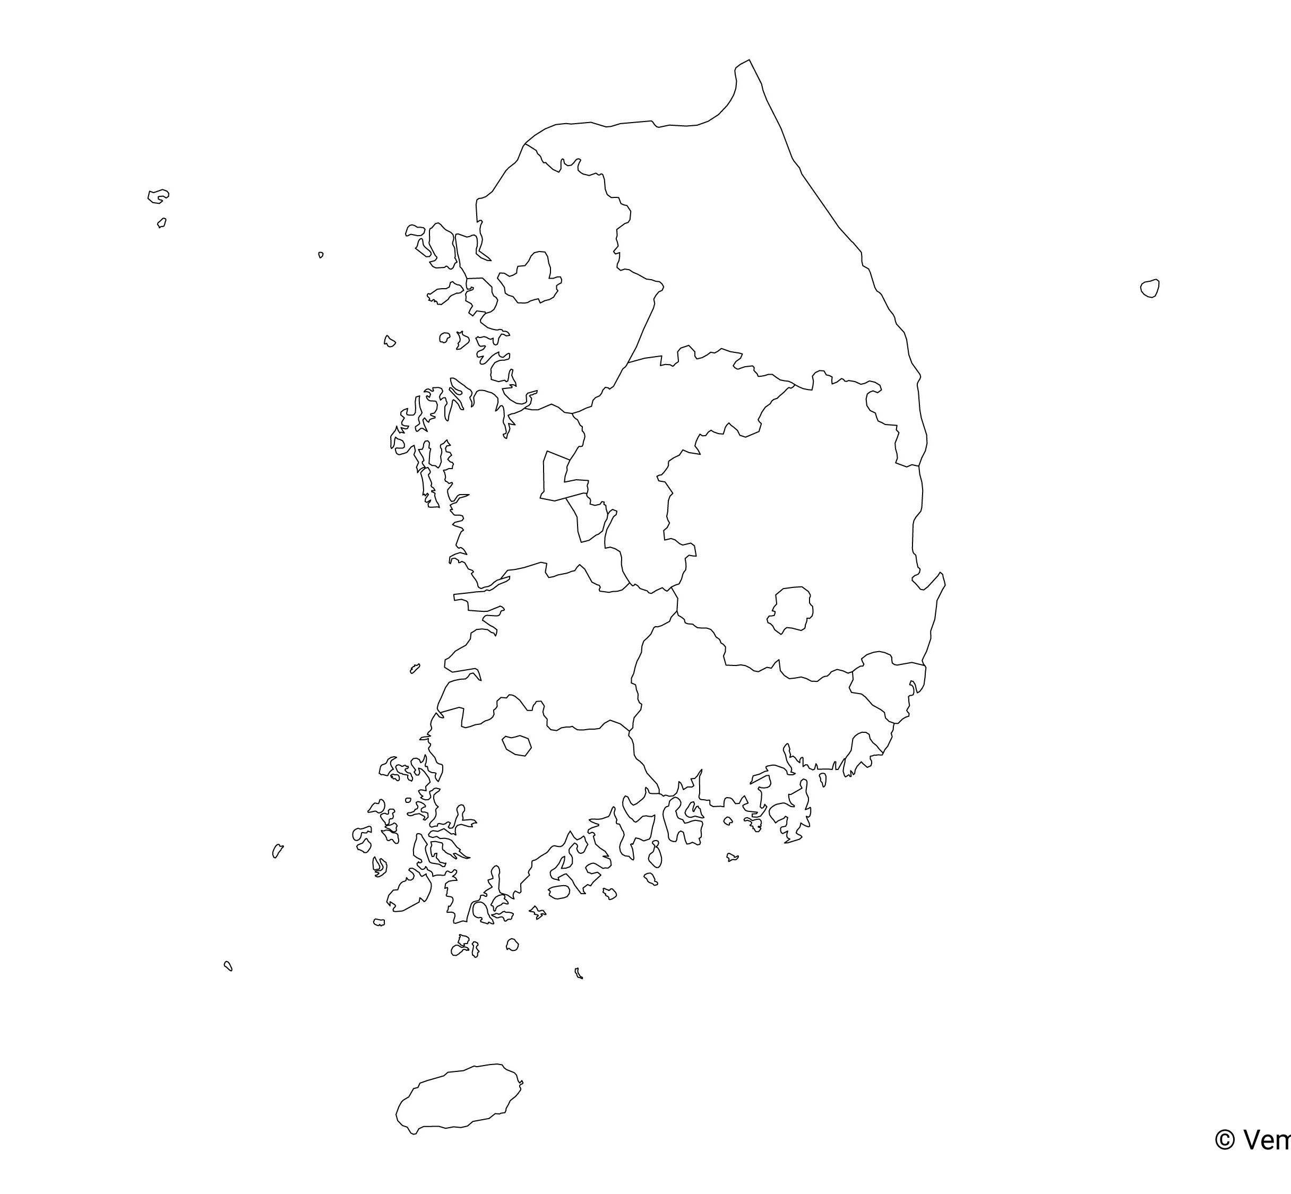
Case Analysis By Province

Slide 4

Business Questions
Which province in South Korea is most affected by COVID-19?
Which city in South Korea is most affected by COVID-19?
What is the cause for the rise in cases in South Korea?
Which place is the most common reason for the rise of COVID-19 in South Korea?

Slide 5
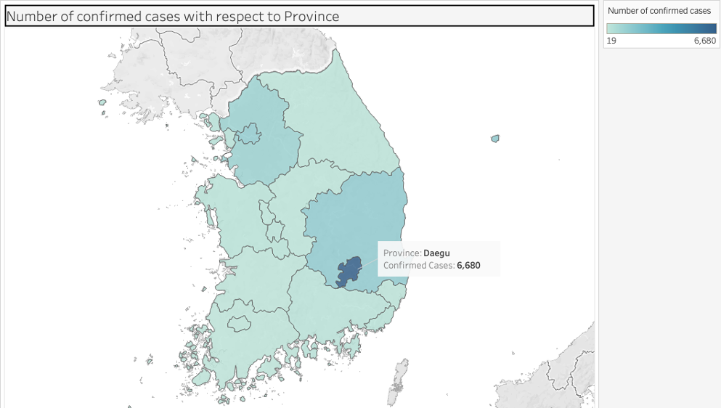
Number of COVID infections respect to Province in South Korea

Slide 6
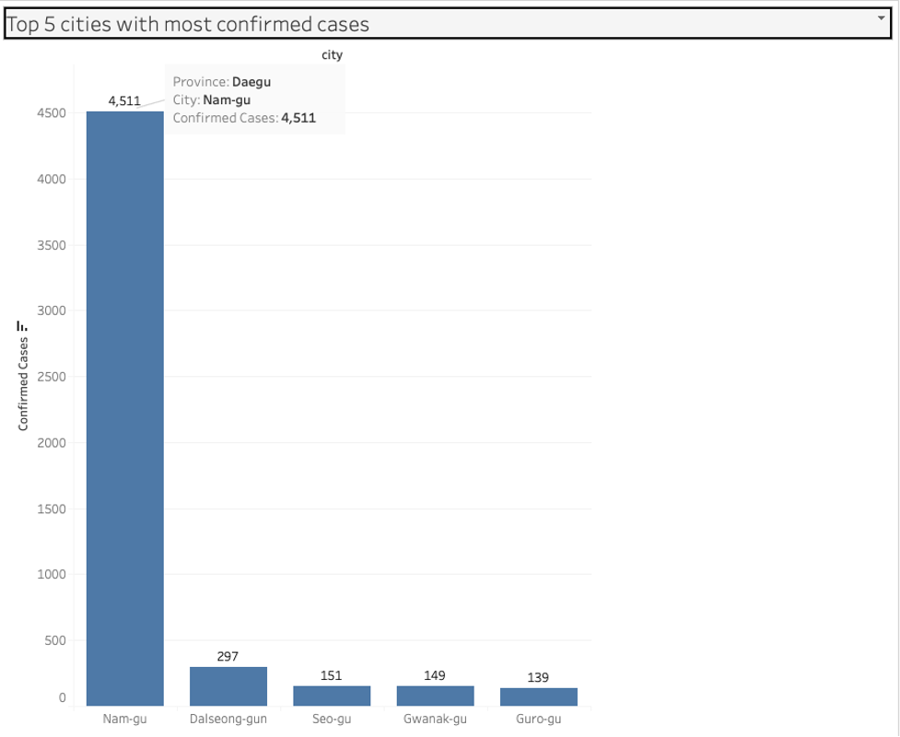
Top cities affected by COVID in South Korea

Slide 7
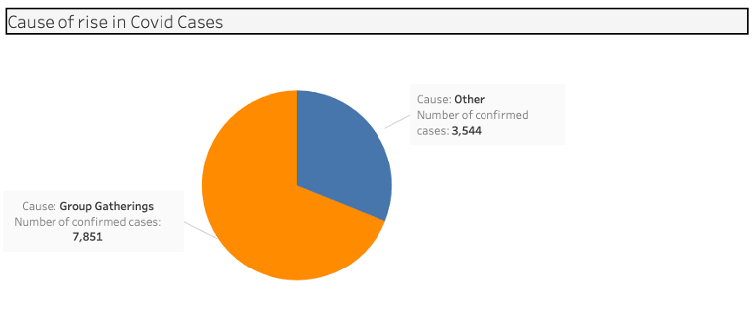
Major causes of rise in COVID in South Korea

Slide 8
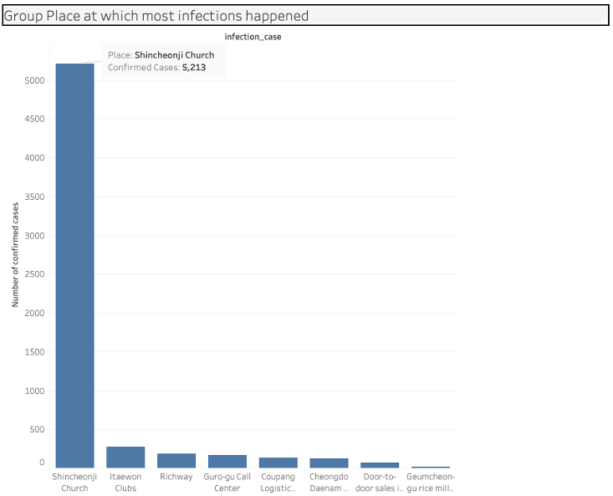
Place with most infections in group gatherings

Slide 9
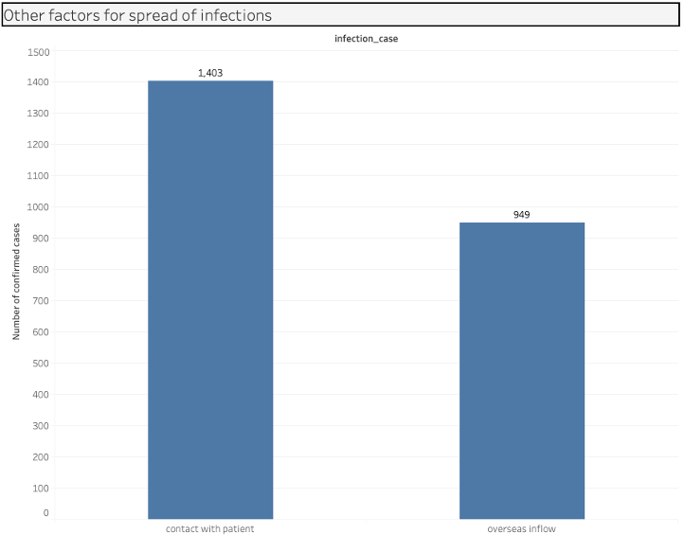
Other factors for rise in COVID infections in South Korea

Slide 10

Patient Analysis

Slide 11
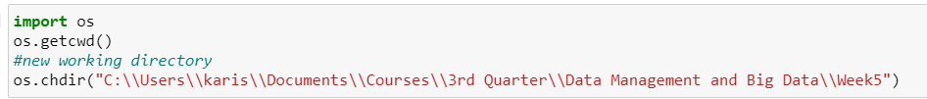


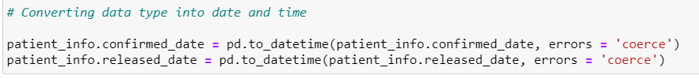
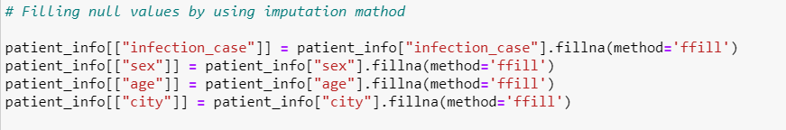
Step : 1
Step : 2
Step : 3
Step : 4
Step : 5
Step : 6

Slide 12

Business Questions
Mortality rate in respect to gender?
Age of patients who are more vulnerable to COVID virus?
What is the median age of patient in respect to different countries?
What is the average time span of a patient staying in hospital?

Slide 13
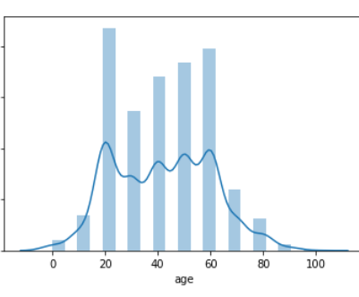
Age Distribution Plot

Slide 14
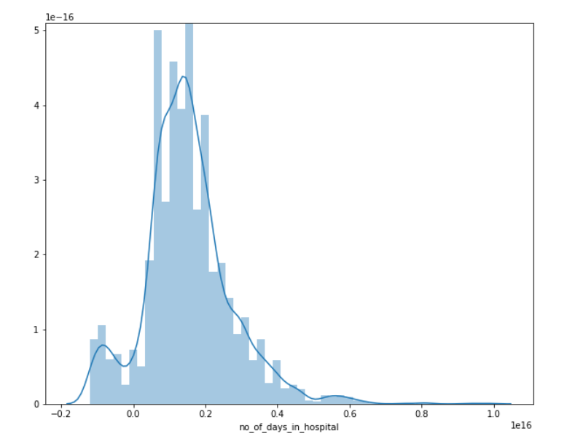
Average number of days patient spent in hospital

Slide 15
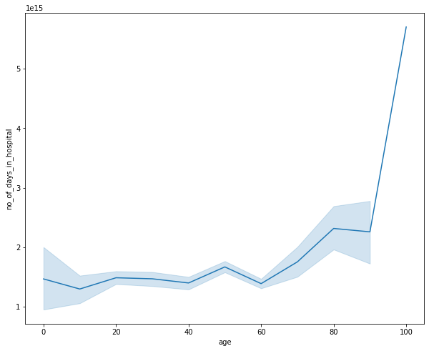
Number of days spent in hospital in respect to age

Slide 16
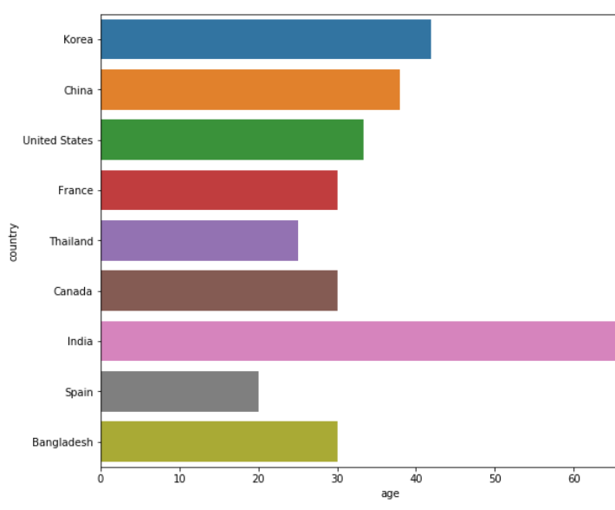
Median age of patient in respect to countries

Slide 17
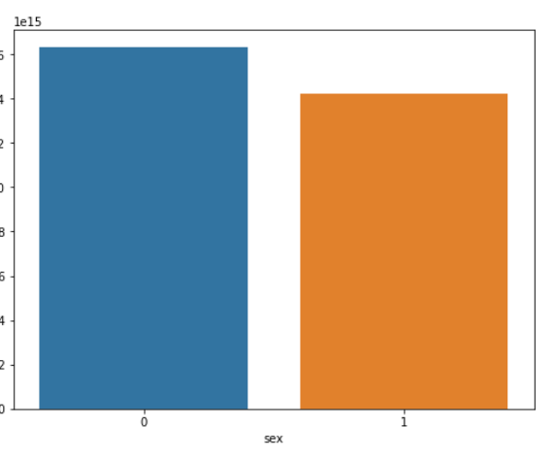
Patient ratio in respect to gender

Slide 18

Time series Analysis

Slide 19

Business Questions
What is the death rate with respect to gender?
What is the death rate with respect to age group?
Which gender is more vulnerable to COVID?

Slide 20
Data Pre-processing Stage
1.Understanding the dataset
2.Pre-processing the data to fill in the missing value
•Identifying the duplicate records
•Dropping the non-value-added columns
•Removing the symbols for “s” and “,”
•Performed one-hot encoding for categorical variables

Slide 21
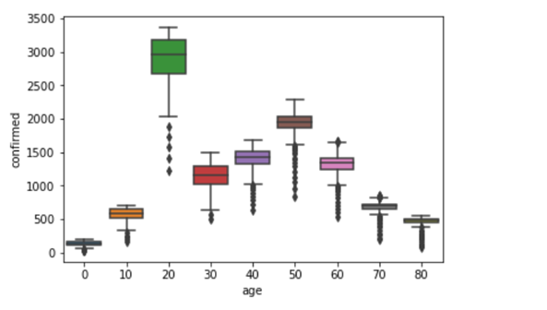
Confirmed COVID cases by Age Group Distribution Plot

Slide 22
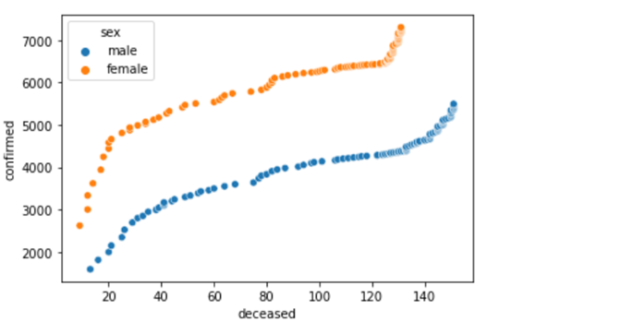
Deceased patients based on Gender

Slide 23
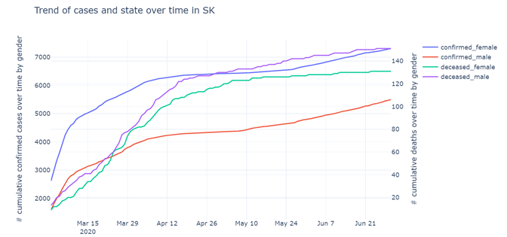
Deceased patients based on Gender

Slide 24
Conclusion
CASE ANALYSIS
PATIENT ANALYSIS
AGE AND GENDER ANALYSIS
We found out that the number of cases reported with contacted patients is higher than the overseas inflow. Also, women are more highly susceptible to COVID. The deaths are higher for the age group between 20 to 30.
We found that infections are increasing more group gatherings as compared to other factors especially at churches. Daegu province has the highest number of infections in South Korea.
Overall, we conclude that older people are more vulnerable to this virus and it take more recovery time for them as compared to younger crowd.

Slide 25
References
DS4C: Data Science for COVID-19 in South Korea. Retrieved from. https://www.kaggle.com/kimjihoo/coronavirusdataset
Kimjihoo. [DS4C] What is this dataset (Detailed Description). Retrieved from. https://www.kaggle.com/kimjihoo/ds4c-what-is-this-dataset-detailed-description

Slide 26

THANK YOU

